Slide 1
UNDERSTANDING AGENTIC A.I.
Dushyant Prabhakar (DP12952), Ganesh Sriramulu (GS12388)

Slide 2
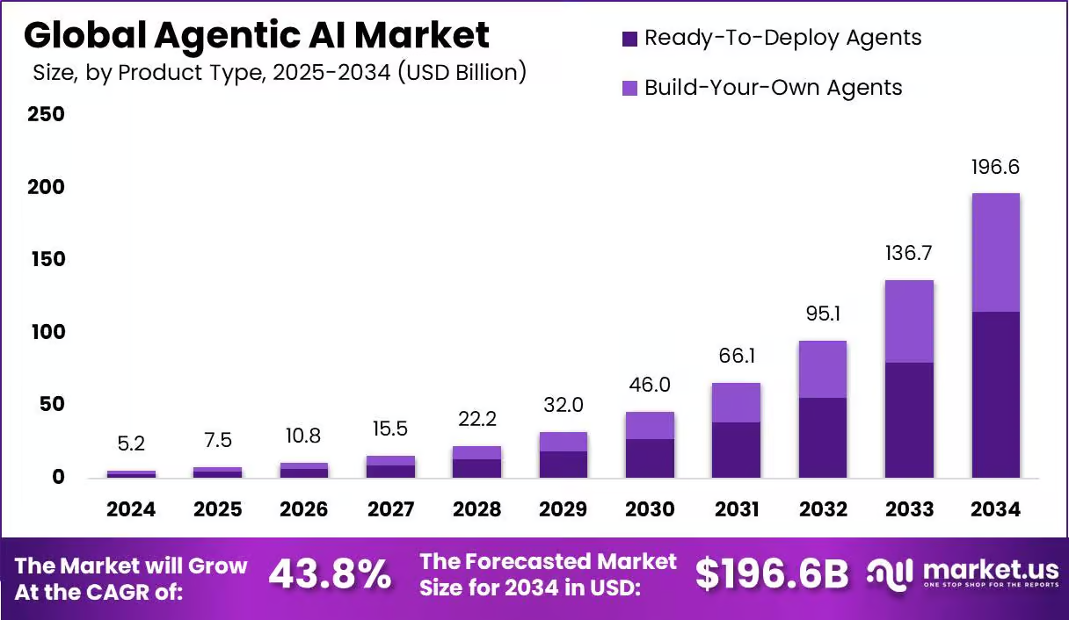
Planning & Governance
Analyze stakeholder needs
Set clear implementation goals
Design tailored AI agents
Ensure regulatory compliance
Identify key priorities for agentic AI.
Define measurable outcomes for deployment..
Align agents to specific workflows.
Meet all legal and ethical standards.
Strategy & Execution
Form partnerships
Highlight value
Optimize cost & ROI
Choose platforms
Businesses need proactive, goal-driven automation. (McKinsey, 2024)
Traditional AI is limited to narrow, reactive tasks. (Stanford AI Index)
Collaborate with AI vendors and experts.
Showcase benefits over traditional AI.
Plan budgets and track returns.
Select the right systems for rollout.
Industries demand intelligent workflow automation. (PwC, Future of Work)
Why the need for agentic AI?
Real-time adaptation to dynamic environments is critical. (Harvard Business Review)
Adoption & Risk Management
Human capacity can’t keep up with growing workload demands. (World Economic Forum)
Tasks are becoming too complex for static AI systems. (MIT Technology Review)
Align to industry needs
Engage & train users
Allocate resources
Mitigate risks
Risk detection and response must be proactive and autonomous. (Gartner, 2024)
Data insights need immediate, autonomous action. (Deloitte Insights)
Solve domain-specific challenges.
Prepare employees to use agents.
Address biases and failures early.
Assign people, tech, and funds.

Slide 3
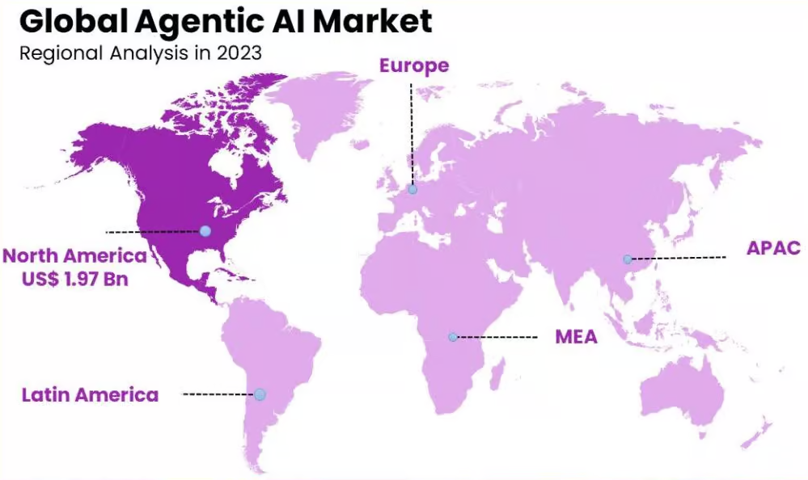
Synergizing Innovation with Agentic AI
Transformative Capabilities of Agentic AI in Enterprise Operations
We seek to explore the transformative potential of agentic artificial intelligence by studying how autonomous, goal‑driven AI systems can enhance business processes, improve decision‑making, and adapt to evolving challenges.
Our understanding highlights key innovations such as cognitive architectures for multi‑step task execution, self‑improving agents that learn and adapt over time, federated agent networks enabling collaboration across systems, and explainable AI to ensure transparency and trust in autonomous actions.
Additionally, we recognize emerging capabilities in continuous learning, situational awareness, and intent prediction that allow agentic AI to anticipate needs, minimize errors, and operate at scale while maintaining human oversight and ethical safeguards.
Agentic AI can independently manage and coordinate complex enterprise workflows, dynamically adjusting tasks across teams and systems to improve efficiency and reduce human oversight.
3
5
Workflow Orchestration
Agents can continuously monitor operations to detect emerging risks, analyze potential impacts, and autonomously implement mitigation strategies to safeguard business continuity.
Risk
Detection
2
4
Agentic AI enables hyper‑personalized, context‑aware engagement with clients by learning preferences, anticipating needs, and tailoring interactions in real‑time across channels.
Client Personalization
Global Agentic AI Market-Map
Agents intelligently allocate resources — such as staff, budgets, and technology — based on evolving priorities, workloads, and constraints, minimizing waste and maximizing output.
Da
Resource Optimization
Agentic AI can autonomously reconcile, clean, and standardize data from disparate sources, creating a single source of truth for analytics and decision‑making.
Data Harmonization
Agents can monitor processes against regulatory and policy frameworks, flagging or correcting non‑compliance in real‑time to minimize legal and reputational risks.
Compliance Monitoring

Slide 4

APPROACH
Approach
CLOSED-LOOP AGENTIC AI SYSTEM
Task
Break-down
Agentic AI breaks complex goals into manageable subtasks automatically.
Goal Setting:
The system receives a high-level objective and breaks it into smaller, actionable tasks.
Autonomous Scheduling
Learning:
Insights are stored to improve performance in the next cycle.
Scheduling:
Agents prioritize and schedule tasks based on urgency and available resources.
Agents prioritize and schedule subtasks dynamically based on constraints and urgency.
Collaborative Agents
Multiple agents coordinate and negotiate to achieve shared objectives efficiently.
1
Evaluation:
Results are compared against goals to identify successes and gaps.
Execution:
Agents carry out tasks in parallel, coordinating with each other as needed.
Context Awareness
Agents adapt behavior based on real‑time changes in the environment or user needs.
Monitoring:
Agents track progress and adapt to real-time changes in context.
Feedback
Loop
Agents learn from outcomes, refine strategies, and improve future performance.
HARDWARE AND SOFTWARE
IINNOVATION OF SOLUTION
SCALABILITY AND FEASIBILITY
Agent orchestration platform
API gateways for system integration
Data streams & sensors for real‑time inputs
Knowledge graphs for context awareness
Policy engines for rules & constraints
Cloud or edge computing infrastructure
Modular agent designs for easy scaling
Works with existing IT environments
Customizable to different domains
Reduces operational overhead
Supported by open‑source & enterprise platforms
Cost‑effective long‑term maintenance
AGENTIC AI FRAMEWORK
Enables autonomous, goal‑driven operations
Supports multi‑agent collaboration
Minimizes manual intervention
Enhances adaptability to changing conditions
Scalability
COMPONENTS
AGENTIC SYSTEM

Slide 5

FEASIBILITY AND SCALABILITY
INNOVATION OF SOLUTIONS
AGENTIC AI IMPLEMENTATION
Autonomous goal achievement
Context-aware decision-making
Continuous self-improvement
Real-time adaptability
Economic: Reduces operational costs by 40–60% through autonomous task execution and optimization.
Systems design
Deployment
Optimization
Autonomous Intelligence
Define agent roles (e.g., Researcher, Executor, Validator).
Integrate APIs for tools like web search, code execution, and databases.
Ensure ethical guardrails and audit trails.
Train agents on domain-specific data (e.g., healthcare, supply chain).
Deploy hybrid cloud/edge architecture for scalability.
Monitor performance via real-time dashboards.
Use reinforcement learning for iterative improvement.
Scale agent teams dynamically based on workload.
Audit outcomes for bias/accuracy.
Operational: Self-directed AI agents improve efficiency via real-time adaptation, reducing human intervention by 80% in routine processes.
100x faster data processing
Reduced human error
Multi-agent collaboration
Cost-efficient automation
Transparent action logs
Cross-domain applicability
Agentic AI systems demonstrate higher accuracy and scalability compared to traditional AI, enabling enterprise-wide deployment.
Operational Advantages
By autonomously learning and acting, Agentic AI can transform industries like healthcare, logistics, and R&D, achieving 10x faster problem-solving.
PROCESS OF BLOCKCHAIN INTEGRATION FOR AGENTIC AI
HARDWARE AND SOFTWARE
1
Smart contracts automate agent coordination by encoding collaboration rules and incentives on-chain. This enables trustless multi-agent systems that self-manage tasks and rewards.
Blockchain logs enable real-time monitoring of agent behavior. Smart contracts can auto-flag anomalies and trigger corrective actions without human oversight.
Agents earn tokens for completed tasks, creating an internal economy. These tokens can be exchanged for resources or system upgrades.
Agent Frameworks: AutoGPT, BabyAGI, LangChain
Cloud Infrastructure: AWS Bedrock, Microsoft Copilot Studio
Data Tools: Snowflake, TensorFlow, PyTorch
UI/UX: Voice/chat interfaces (e.g., ChatGPT API)
Security: Homomorphic encryption, Zero-Knowledge Proofs
Hardware:
NVIDIA H100 GPUs
IoT edge devices
Robotics integration kits
1
3
5
Smart
Contract Governance
Immutable Action
Ledger
Autonomous Auditing
Decentralized AI Marketplace
Tokenized Contributions
AI Consulting Services
2
4
All agent decisions are permanently recorded on blockchain, creating a tamper-proof audit trail for compliance verification and transparency.
Agents autonomously bid for tasks and trade services in a blockchain-powered marketplace, optimizing resource allocation through competitive mechanisms.

Slide 6
Agentic AI Applications for Personalized Banking
Agentic AI Applications for Personalized Banking
Case 1: Personalized Wealth Advisory using Agentic AI
Case 2: Intelligent Client Engagement & Retention with Agentic AI.
Understand client segmentation, risk appetites, and advisory needs.
Devise an Agentic AI‑driven wealth advisory solution.
Approach client relationship management (CRM) and marketing teams..
Map out client lifecycle and common churn points.
Identify KPIs for engagement and retention improvement.
Approach PBWM stakeholders..
Analyze current advisory workflows and identify inefficiencies.
Check if other wealth managers face similar gaps in personalization.
Propose a pilot with Agentic AI agents simulating advisory sessions.
Collect client feedback to understand pain points.
Design an Agentic AI‑based engagement strategy.
Propose a pilot focusing on a specific client segment.
Evaluate feasibility considering regulatory constraints and client data privacy.
Deploy agents to recommend portfolio adjustments, detect market shifts, and suggest actions.
Agents monitor portfolios and learn client preferences
over time.
Integrate agents across communication channels (app, email, chat).
Agents proactively monitor client activity and sentiment.
Trigger personalized outreach based on milestones and patterns.
Collect feedback from clients and advisors on recommendations.
Check if similar advisory agents can expand to ultra‑HNI or retail segments.
Assess scalability to other wealth segments (ultra‑HNI, mass affluent).
Adjust messaging tone and frequency dynamically.
Log all interactions in CRM for transparency and reporting.
Measure impact on satisfaction, retention, and upsell rates.

